Slide 1

THE LİFE İN ACTİON

Slide 2
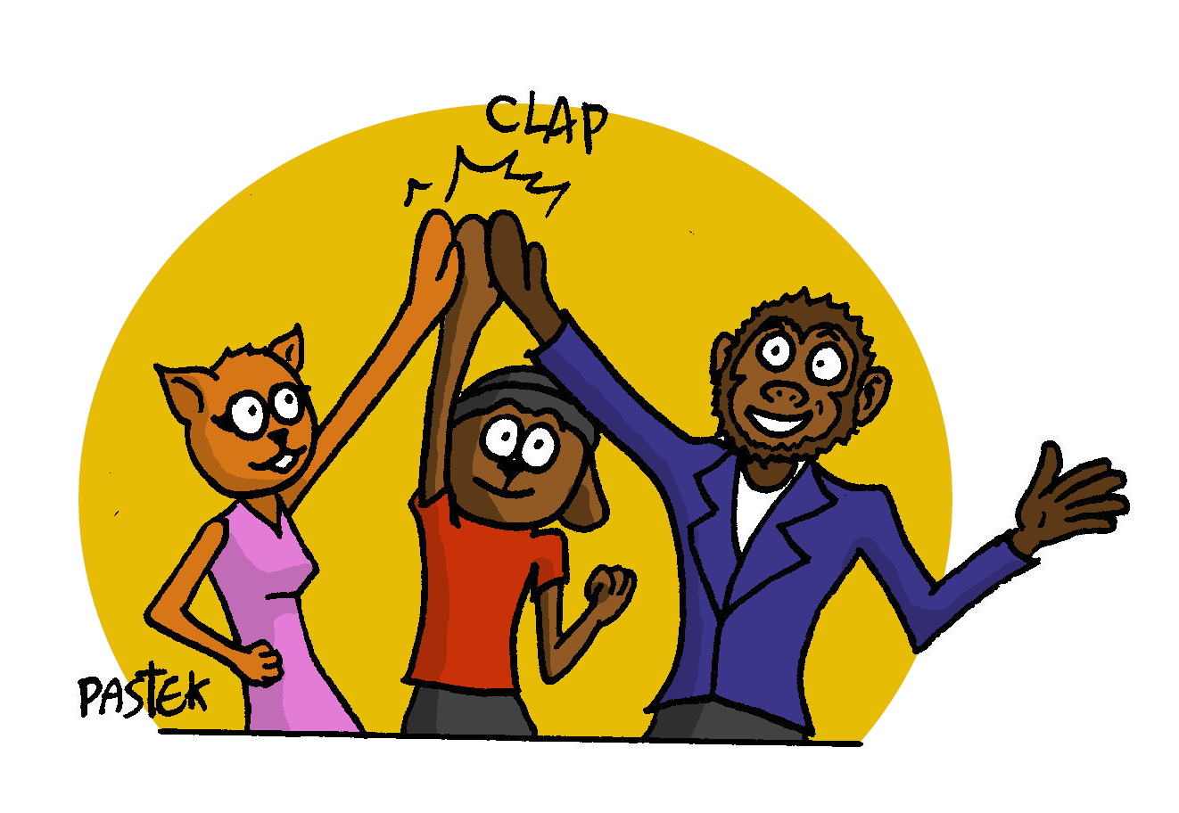
Project context
“Together, we can create a better future for everyone!”

Slide 3


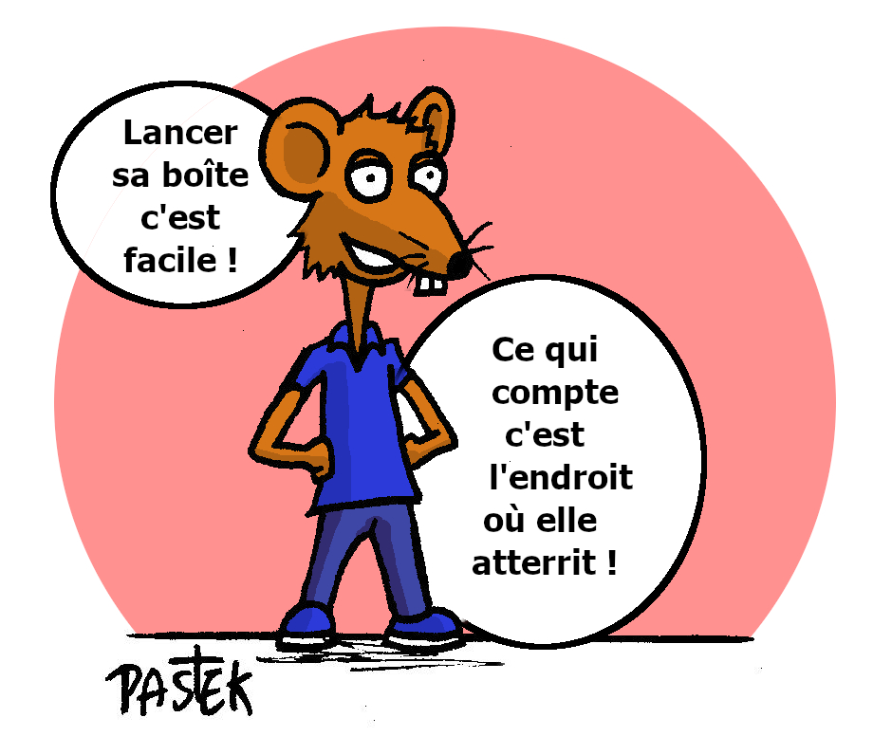
With which “Product-Service”?
► None ! For “Aging Well Long Together”
we have reinvented a network Organization with principles:
Inclusion
This project encourages inclusion and diversity for a more equitable world.
Solidarity
The project emphasizes solidarity and mutual aid for a better future.
Progress
Yes Together aims to build a better future for all based on social and economic progress.

Slide 4

The reason for this project
Carry out humanist citizen action of general interest, apolitical, with social and environmental impact, through another form of cooperation with respect for the territories, in unison,
in FRANCE and LAOS.
A different system of organization
was imagined within neighborhoods while facing climate disruption and aging societies that have become complex, losing meaning and rupture, and which create precariousness, burnout, mistreatment, loneliness...
With what solution?
► An innovative “Human Resources recipe”

Slide 5
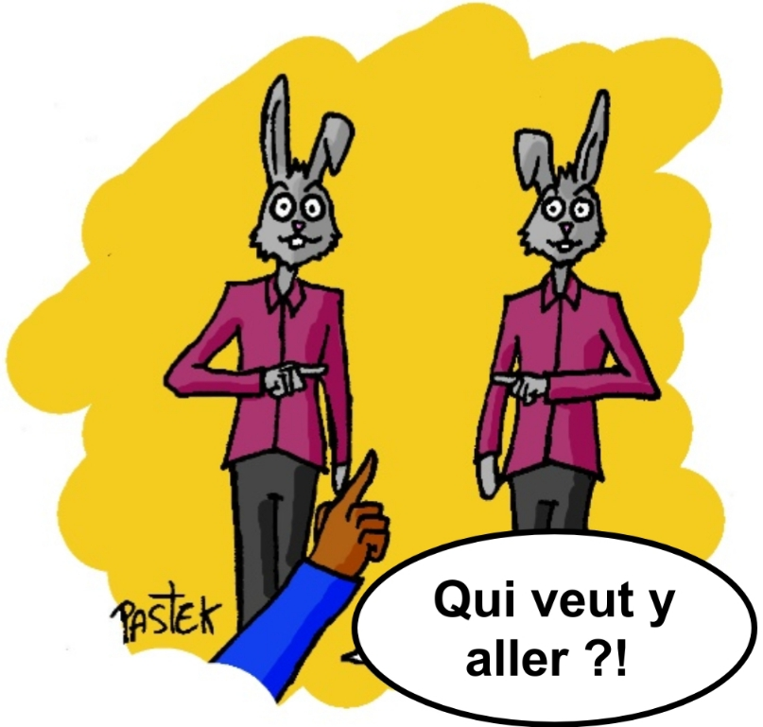
What is the goal of this project?
Create intergenerational harmony while
mobilizing problem stakeholders environmental
and climatic for a sustainable
future.

Slide 6

The idea of the project
The project was born following the testimonies of our elders at the end of life, on the happiness that is found in an alchemy between respect for individuality and that of openness to others
The proposal for action is the result of a succession of human and professional experiences lived in different life contexts, accumulated in developed and developing countries

Slide 7

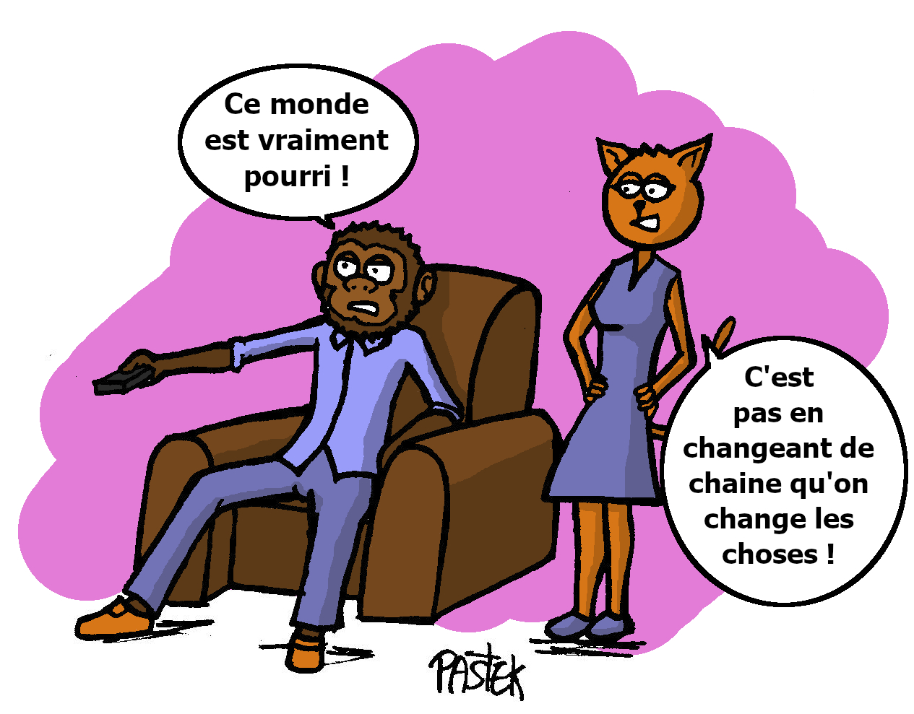
But…
Where is it located?
Why this project?
What societal issue are you working on?
Who are you?
What issues do you raise?
Who is your project aimed at?
How do you approach a complex societal system?
How to achieve the goal of the project?
What do we want to federate?
How can you keep the commitments of your public interest project?

Slide 8
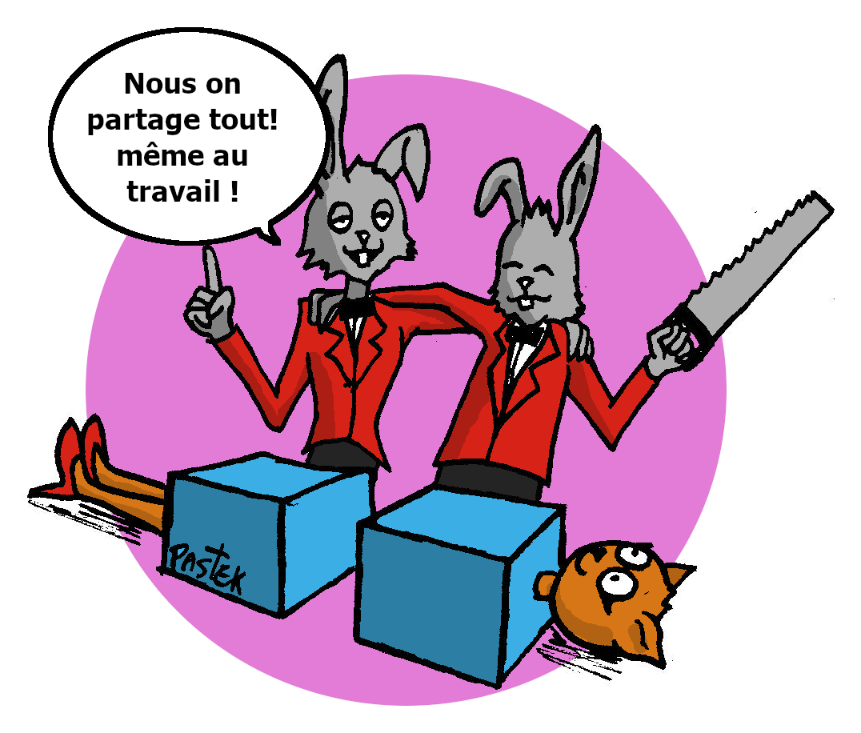
Why this project?
► The health crisis revealed the systemic flaws in our models of society which have become complex
One obvious consequence:
Metamorphosis of our now fractured societies, which requires rethinking them by "repairing" them

Slide 9
Who are we?
Often share the following findings
In parallel, they suffer from the same difficulties
Are poorly connected
Fulfil their responsibilities
Carry altruistic and ethical values
Motivate "win-win" relationships
Multiple entrepreneurial resources that are
intergenerational, multicultural, multisectoral:
public and private actors
paid and voluntary

Slide 10
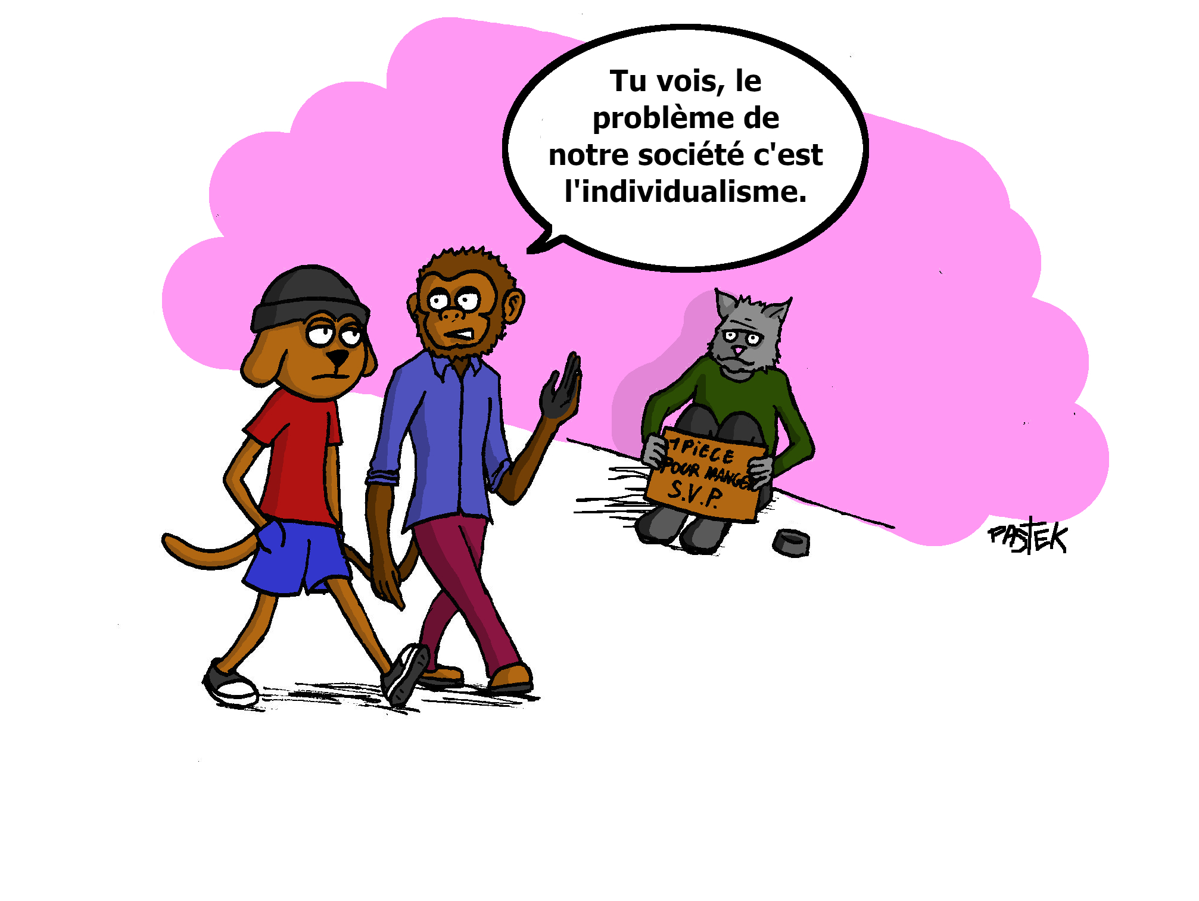
What issues do we raise?
unemployment of the younger generation
Precariousness
abuse
home maintenance
burn out
Aging
break
Intergenerational gap
unemployment of seniors
isolation
Climate change

Slide 11
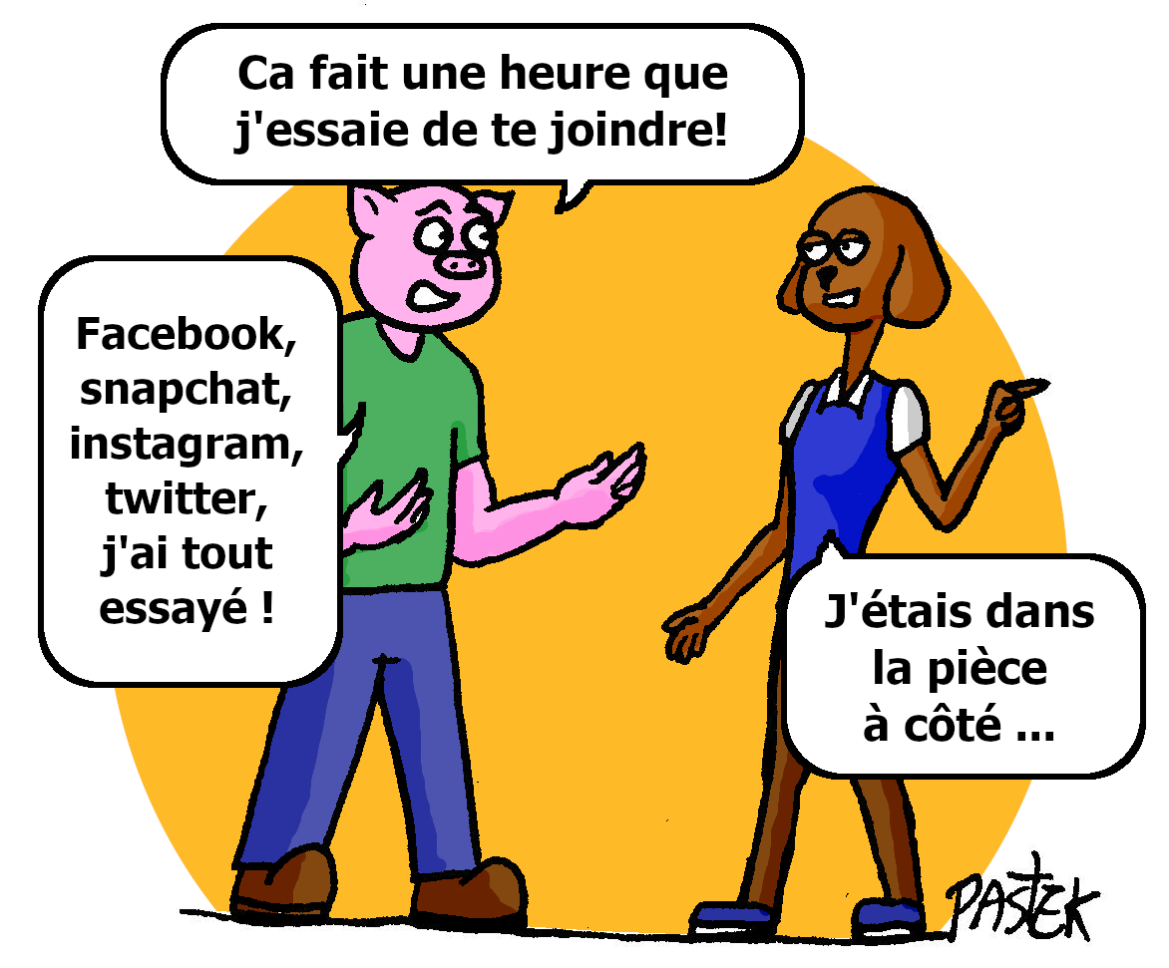
How do we approach a complex societal system?
► Faced with the volume of problems to be solved:
decision to operate using a preventive approach, which requires us to use a holistic project design process, i.e. global and transversal
Putting the « Human being » at the centre of our concerns for Living Well Together

Slide 12
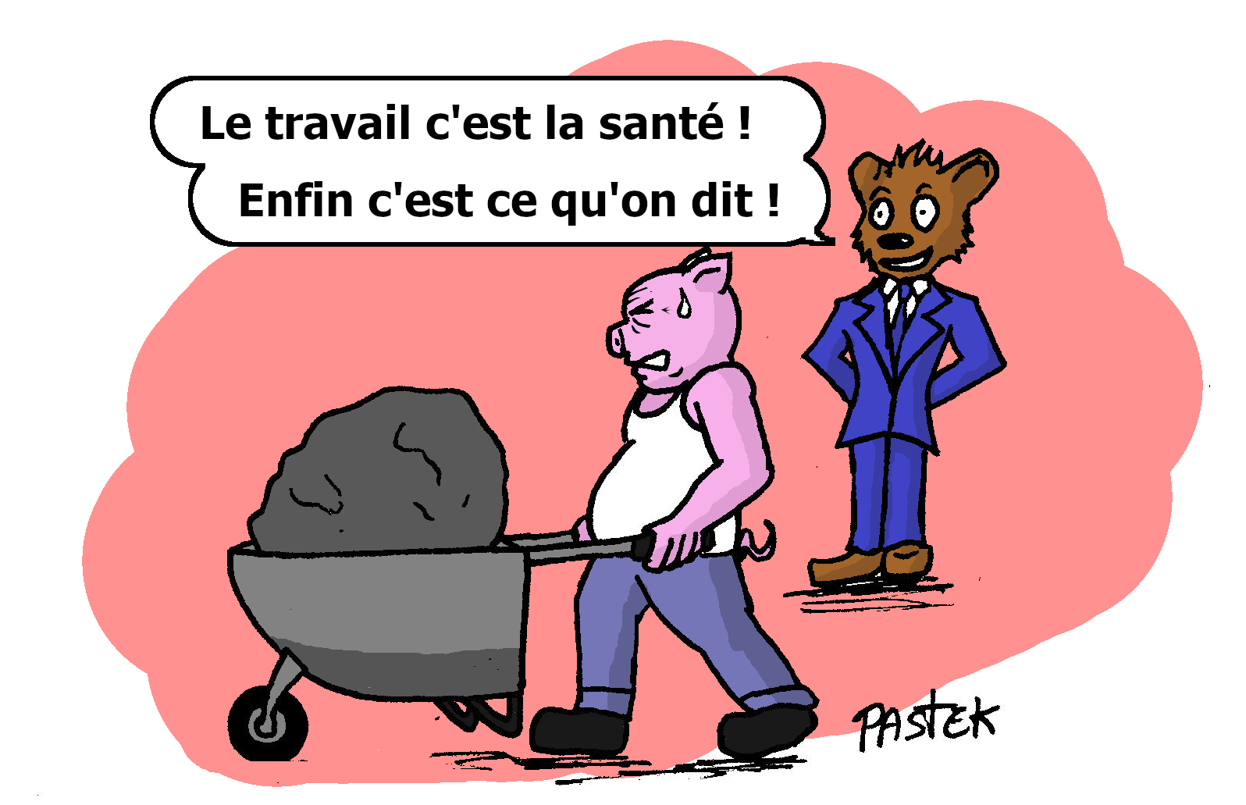
What do we want to federate?
►A concept of live open to the word by surveying the long path of:
« Retention of activity in a different light »
To delay the slide towards dependency (in the broadest sense of the term, i.e. financial, physical, emotional and psychological)

Slide 13

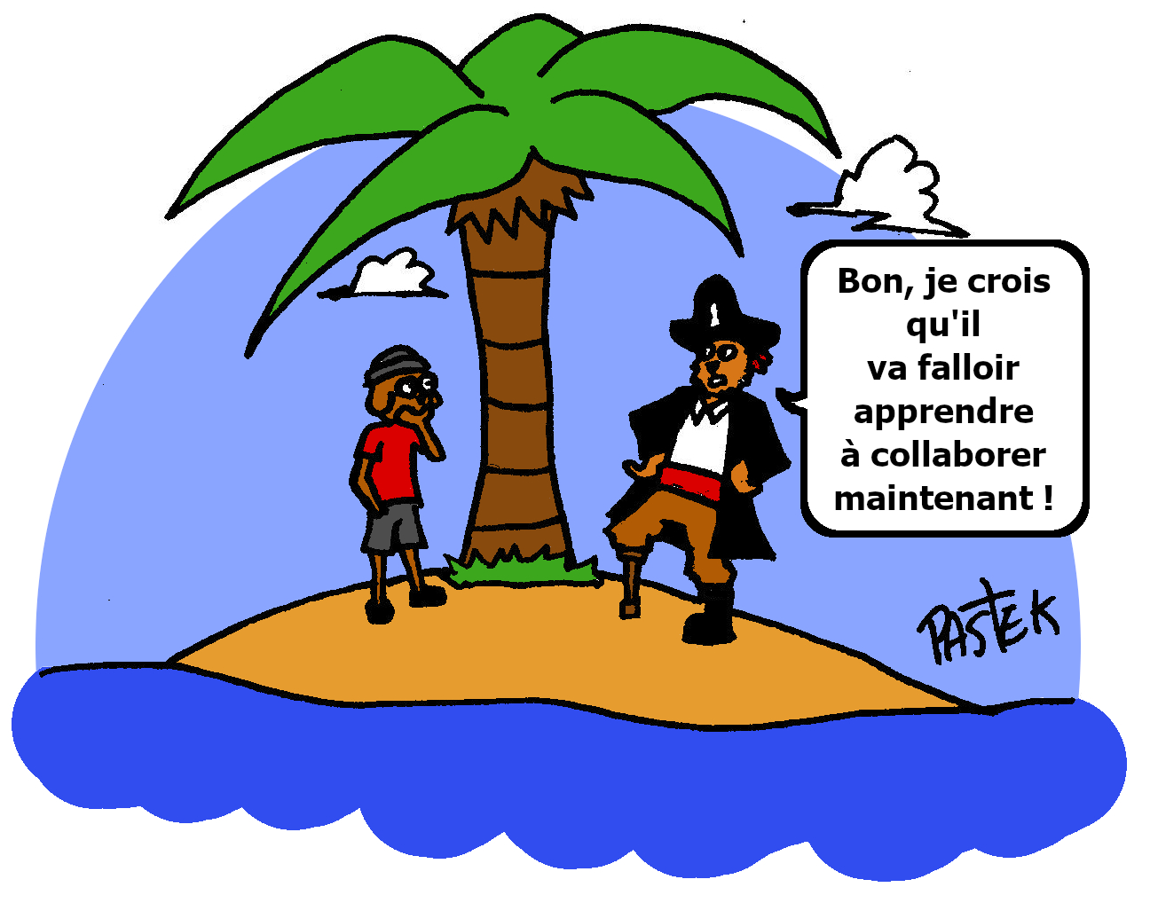
Where is the project experimentation located?
► In France, a developed country, and in Laos, a developing country, in unison:
Because the interactions between "Humans" and the ecosystem with their multiple effects on living beings
goes beyond borders
Because in the face of precariousness and ageing populations, the problems are comparable, apart from a difference in the habits and customs of life linked to the climate and culture

Slide 14
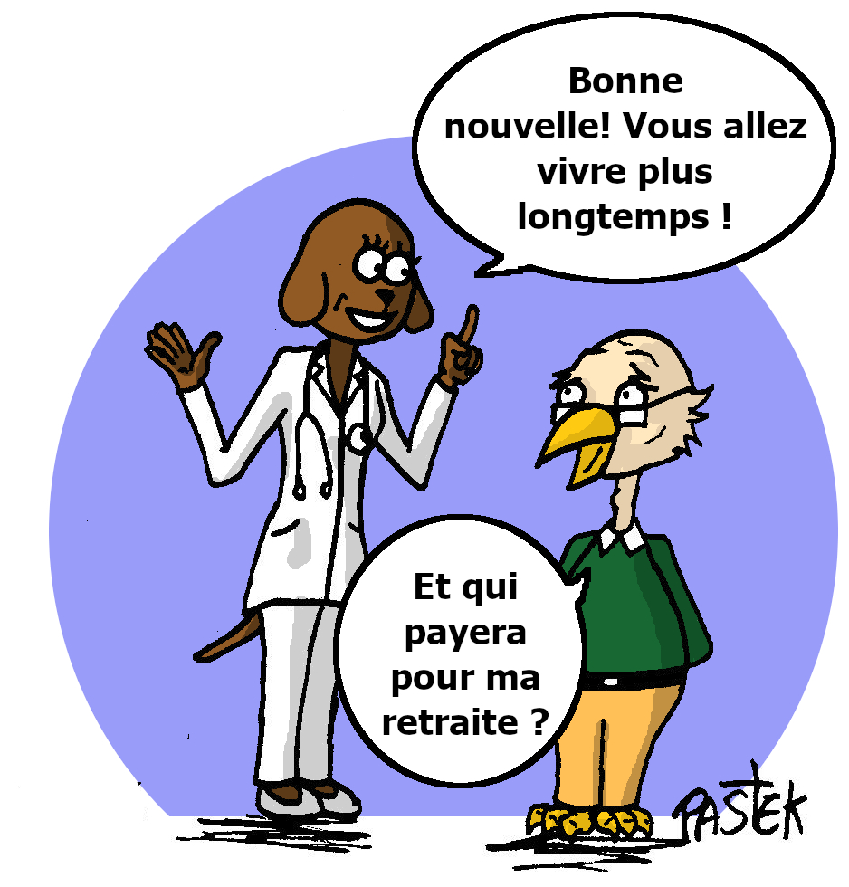
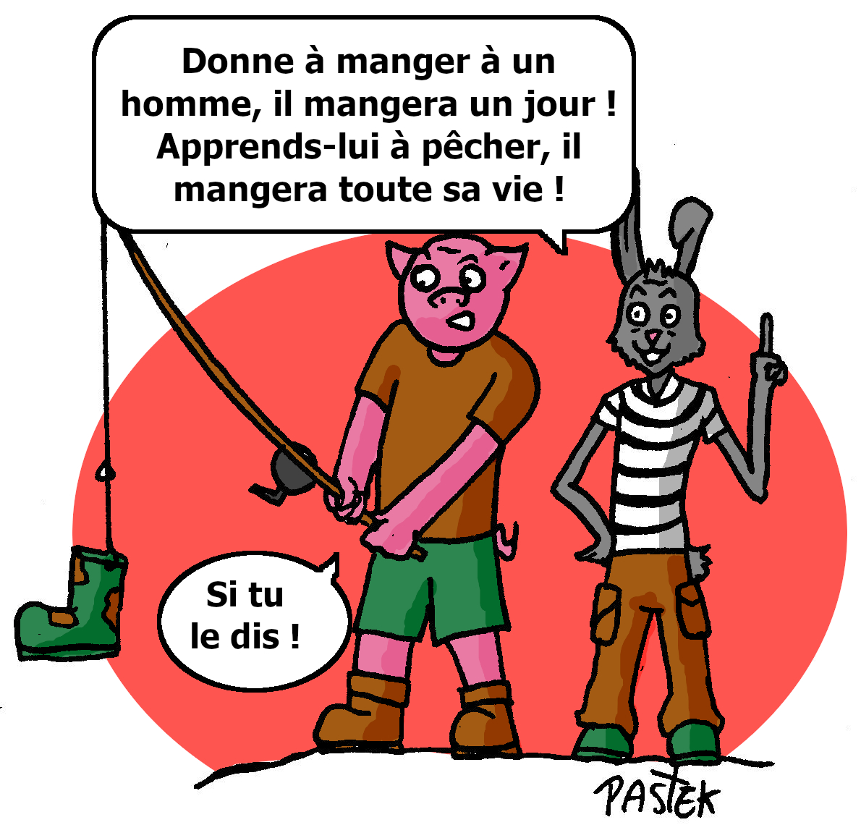

What societal issue are you working on?
Imagined to innovate socially and unleash the opportunities of people and organisations for the benefit of competitiveness of industries, our Yes Together Life concept is based on one question:
How to articulate over the whole life cycle the times of work, training, unpaid activity or retirement, and corresponding income:
► Laying a stone in the building of projects that feed the "Green Future" for « Aging Well Together » ?

Slide 15
Who is our project aimed at?
To Human Resources (HR) and those persons wishing to stay active
Remaining the author of one’s life within a collective
to delay the slide into dependency (in the broadest sense of the term: financial, physical, emotional and psychological)
To have a job and activities recognised and remunerated at their fair value by avoiding illegal channels that harm the professional image
Build up a decent income by carrying out assignments serving living beings, close to home to limit travel time and costs
To evolve autonomously
without isolating oneself and
finding oneself on the margins
of the professional word
Receive training that improves job quality and retention at every stage of life

Slide 16
To service recipients
Collaborate within a
solidarity network serving living beings
Benefit from quality services through the human qualities and technical skills of the staff
To have a simple management of multiples services, by combining organisation and taking into account the personalised expectations without affecting the quality
To be able to fund personal support services
To establish a relationship of complicity and trust between carers and supported persons with issues to take into account such as their intimacy, and/or physical and psychological deficiencies and suffering

Slide 17
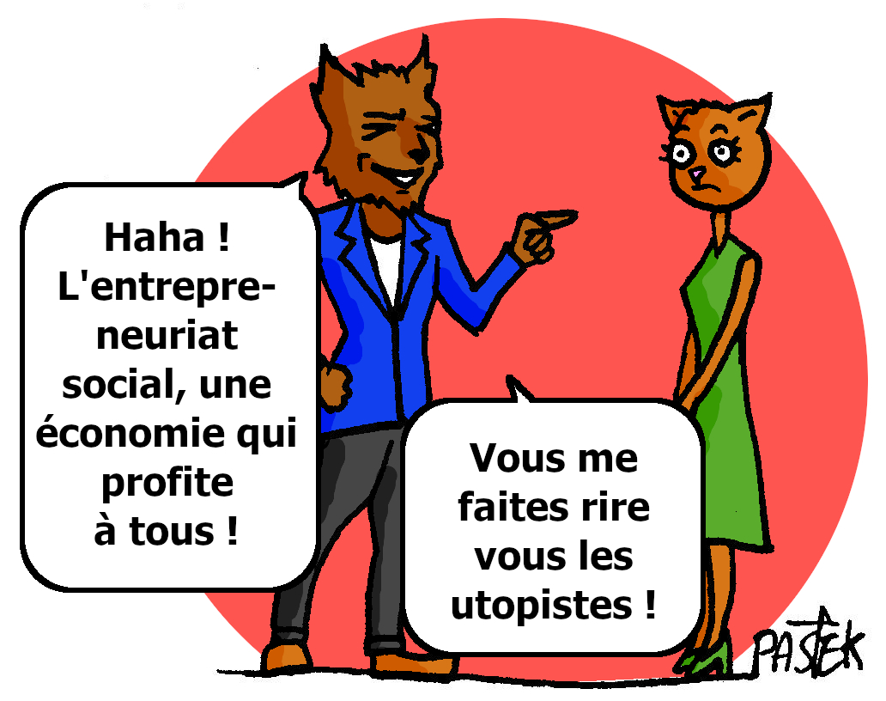

How to achieve the goal of the project?
► The solidarity economy is not a natural approach in the face of the race for more and more…
We are therefore taking the societal shift in favour of the future of our children and the generations to come:
With a recipe composed of 7 ingredients to meet the changing interests and needs of everyone over time

Slide 18
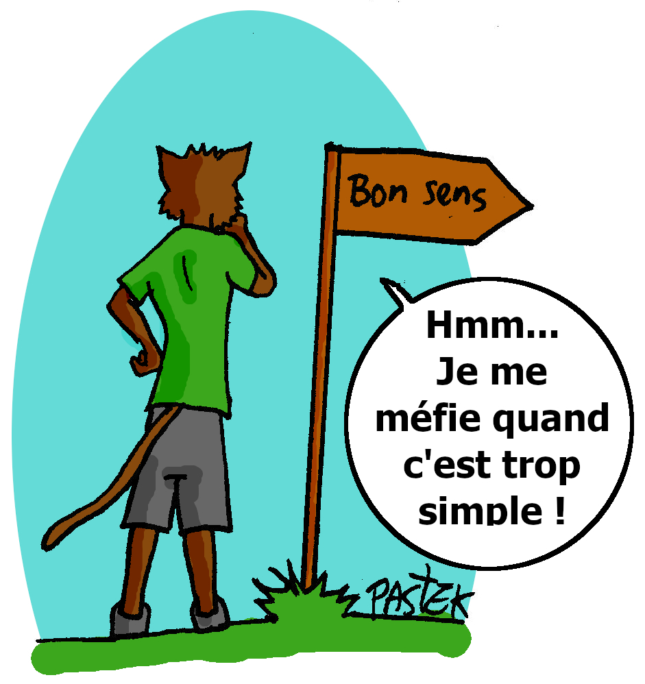
1
An economic model based on interdependencies and forms of autonomy integrated at different scales
Thanks to the project design process that is harmonised globally and cross-sectoral to fit the needs at every stage of life
► Optimization of links between:
management of people, both professional service providers and clients
and the management of lifestyles in respect of the environment

Slide 19
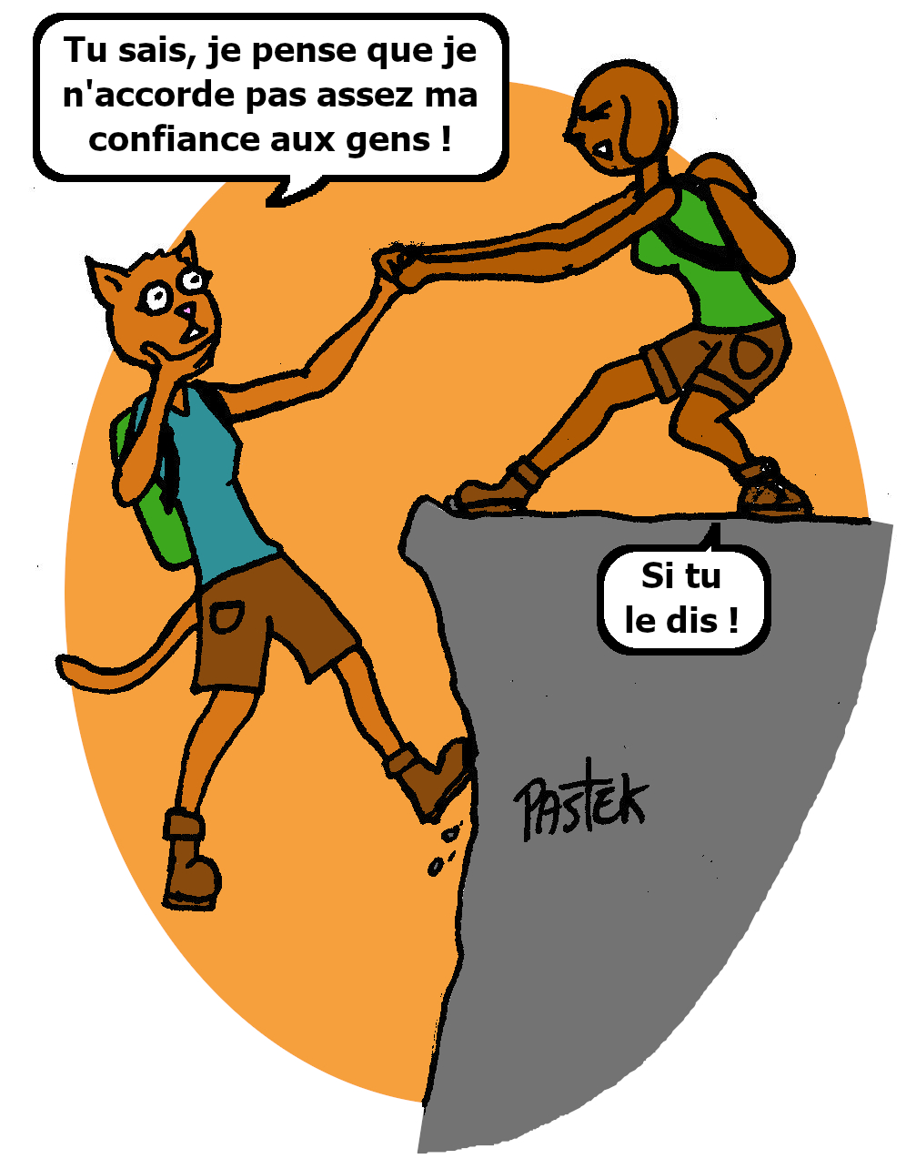
Management with a human philosophy
In the intergenerational and cross-cultural approach
► To develop HR within a network that acts in favour of "Maintaining balance and good health", "Place of life" and "Social life":
Our innovative form of enterprise is combined with an innovative process of work organisation and service production
Re-learning trust
Building relationships
Working on the autonomy of each individual
Securing employment and activity at every stage of life
Bringing our activities in line with environmental responsibility

Slide 20
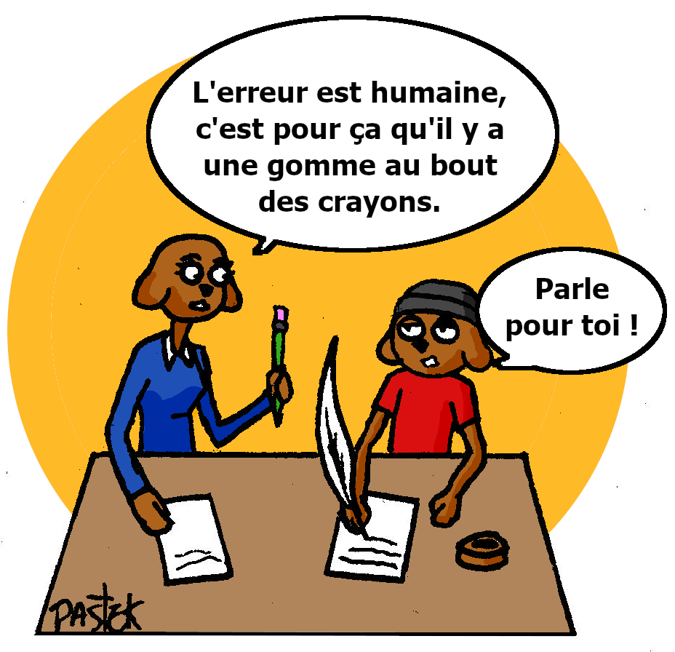
Management with a method
► Overall functioning of the system: production, management, commercial, and feedback to governance
► Preventive mode of operation of psycho-social risks and professional wear-and-tear by training and support
► Demand for comprehensiveness of the service provided: health protected, privacy and living space preserved, social life maintained/enriched, rhythm and preferences respected
► Creation of links between: Yes Together Social Entrepreneurs and Human Resources maintained still in employment, and Common Interest Partners, environmentally responsible producers and suppliers, possibly in alternative trade

Slide 21


Actions structured within 7 interactive activity clusters
2
In the service of
« Human »
centrally located
of our system
Nutrition
Building renovation
services
4
3
Care (health, comfort, well-being, hygiene)
5
A choice of home
services
2
Cultural and artistic
6
Support services to maintain autonomy at home
Sale of environmentally responsible products and services
1
7

Slide 22

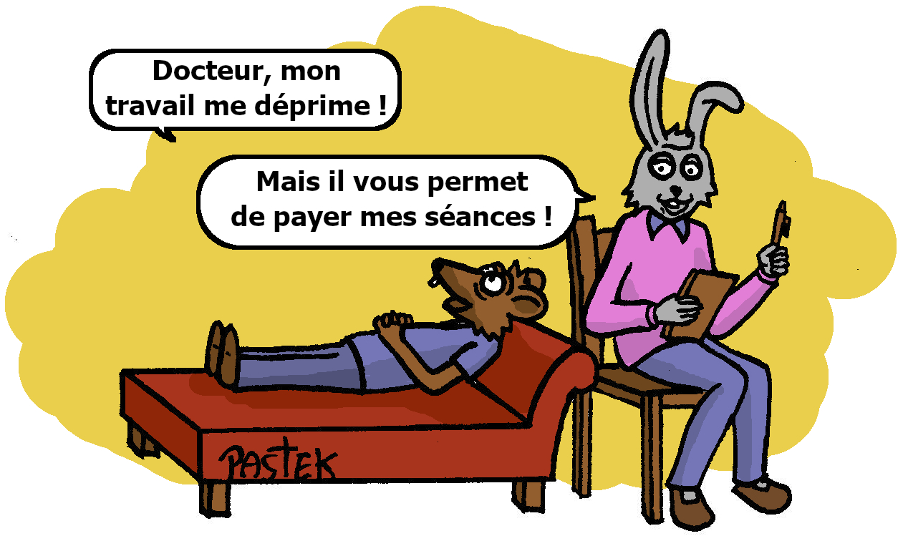
3
Social Entrepreneurs looking out for others
Interacting with people from different cultures and backgrounds and with very different operating frames of reference
Focus on human competence: common sense and discernment
They are capable of introspection, questioning, adaptation, building interpersonal relationships and maintaining team cohesion
They are motivated by human relations built on a responsible relationship of shared trust
They are respectful of the HR Yes Together guidelines (values and interpersonal skills) which guarantee the purpose of qualitative collective work, by satisfying the ‟know-how”, ‟will to do” and ‟power to do”, of the teams

Slide 23
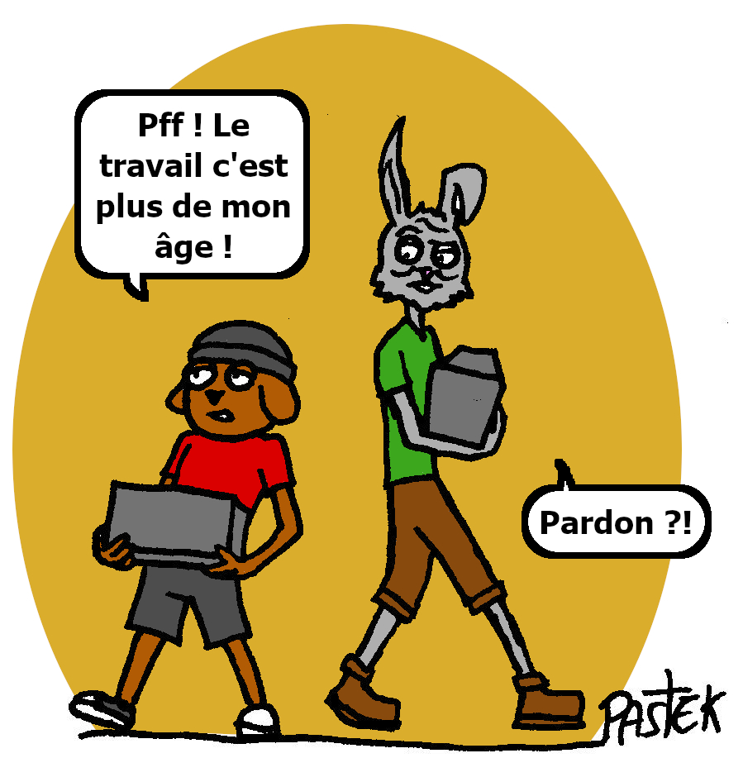
A concept of business continuity other than that of Uberization
4
Social Entrepreneurs Yes Together
► Insert home-based professions into the local economic landscape by facilitating solidarity-based bridges with a legal person intervening for professionalisation and changing the image of these professions
► Seek retention where it is found in local territories by making training and its allocated funds consistent
Everyone is someone’s client
► Meet the needs of different costumer bases (mutual provision of services and customers) through a fair circular economy

Slide 24

Human Resources kept active to mobilise around the common cause of Ageing Well Together
5
► Pooling of cross-cutting HR skills for "Maintaining balance and good health", "Living place" and "Social life"
Yes Together Social Entrepreneurs support Human Resources
By providing shared missions with 1 to 5 key competences used in a transversal mode between the 7 activity clusters: Developer, Recruiter, Trainer, Tutor, Coordinator
By ricochet?
Multiple employment and activity opportunities

Slide 25

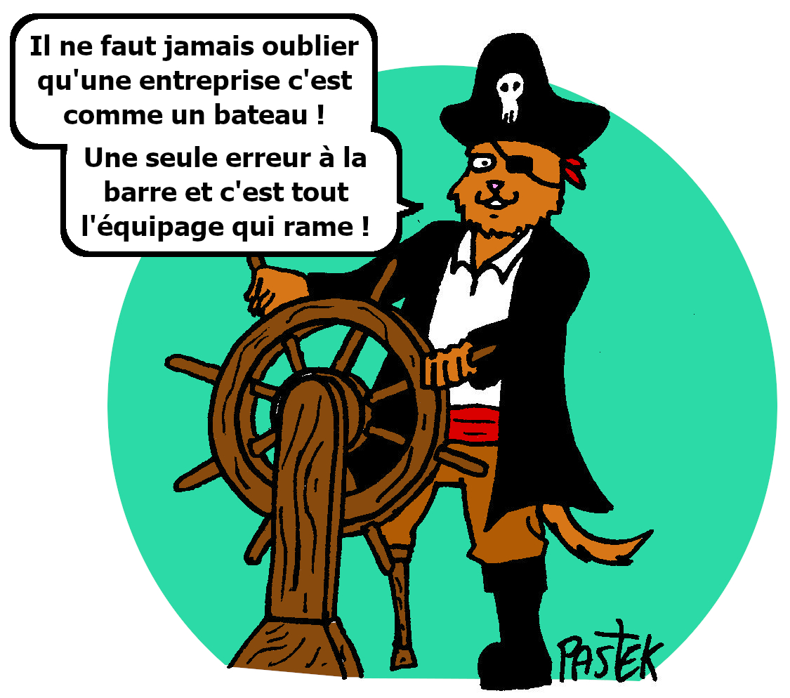
6
Deployment of the circular economy in harmony with everyone’s needs
► Sustainability of the project in unison between the livestyles in France and Laos
By building loyalty through a socially coherent financial package and a legal framework structured on conditions that encourage design and operational skills to work together for the benefit of the protection of individual interests

Slide 26

7
A legal framework orchestrated so as to secure all skill profiles
Framework France
Conceptual Social Entrepreneurs
  Simplified joint stock company
  Concept creation and innovation
  Guarantors of good application of the concept
Operational Social Entrepreneurs
  Two Cooperatives of activities and employment (compliance with legal texts)
  Application of the concept
France
and Laos
PCİ
(Partners in Common Interest)
Public actors
Private actors (under any legal status)
Building together the future:
reconcile
social inclusion,
quality of life at work, and environment
Framework France and Laos
Voluntary Social Entrepreneurs
  Two separate associations based on the "1901 Association law“
  Keepers of the concept
  Contributions through their skills

Slide 27
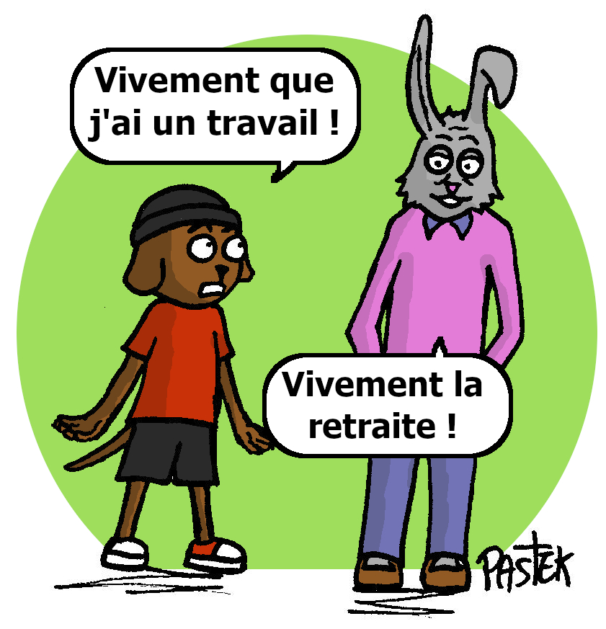
Together with partners having common interests in the face of the volume of problems to be solved
In a long-term collaboration to support the evolution of representations in the world of work
In a realistic vision of the maintenance of activity in the face of chaotic careers, the limitation of the recourse to early total cessation, and the extension of the duration of contributions for full rate pensions

Slide 28
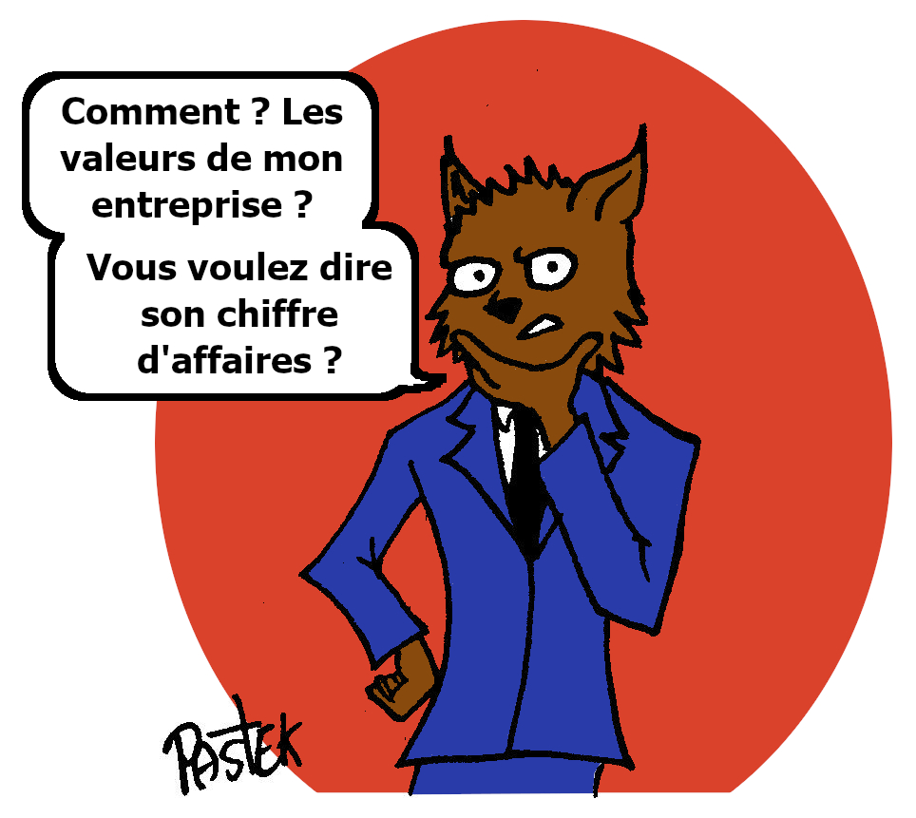
Together with partners with common values to fight against abuses
Creation of a pool of professionals with cross-cutting skills between all professions in the home and those in companies
In order to meet the expectations of clients in their homes: proposal of resources with proven and serious skills, in a notion of personalised, tailor-made and "a la carte" services
In order the meet the needs of companies: recruitment and professionalization of trades; providing employees companies who are suffering, with less arduous missions in the home of clients, as well as tutoring missions

Slide 29
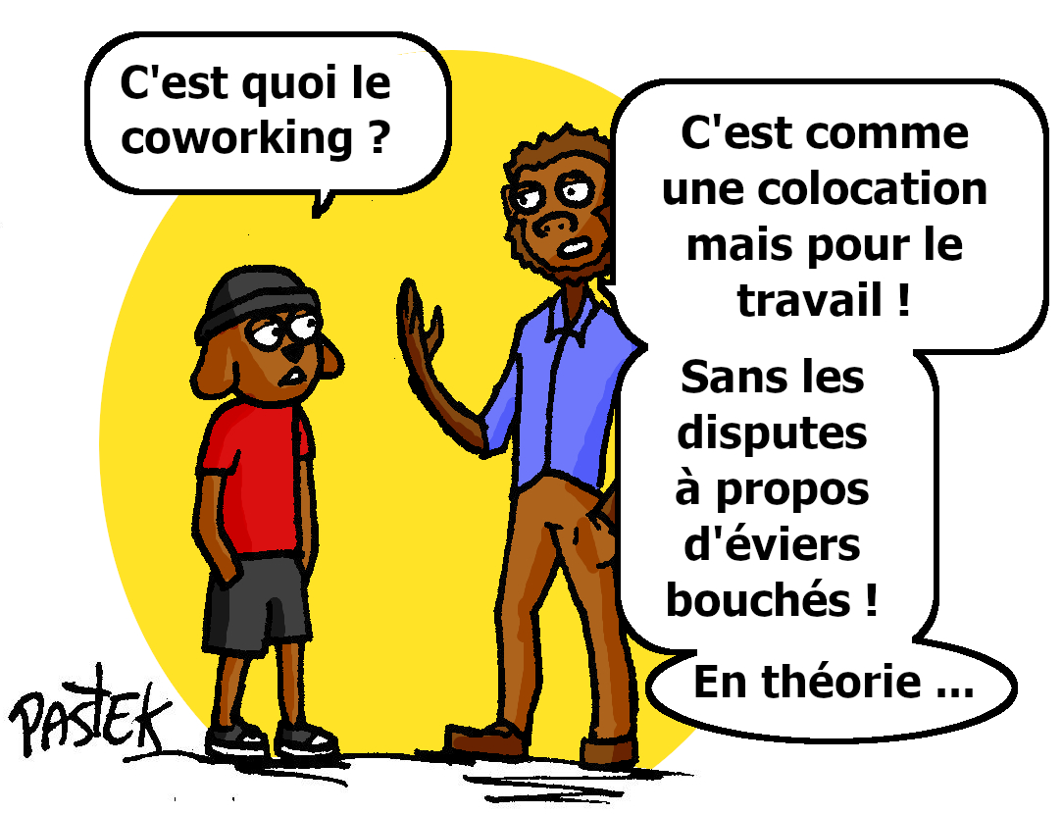
How can you keep the commitments of your public interest project ?

Slide 30
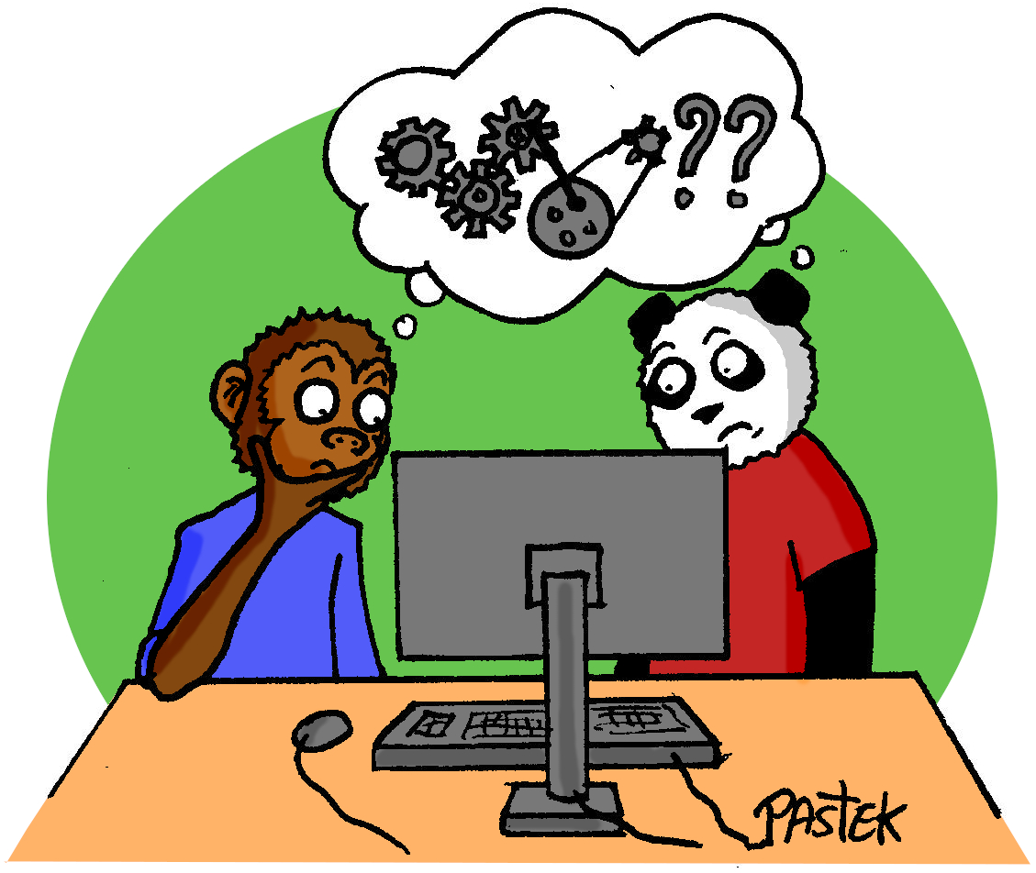
Our obligations
Conducting the action by taking into account
Human capital
Natural environmental capital
Financial capital
Need for a specific HRIS
(Human Resources Information System)

Slide 31
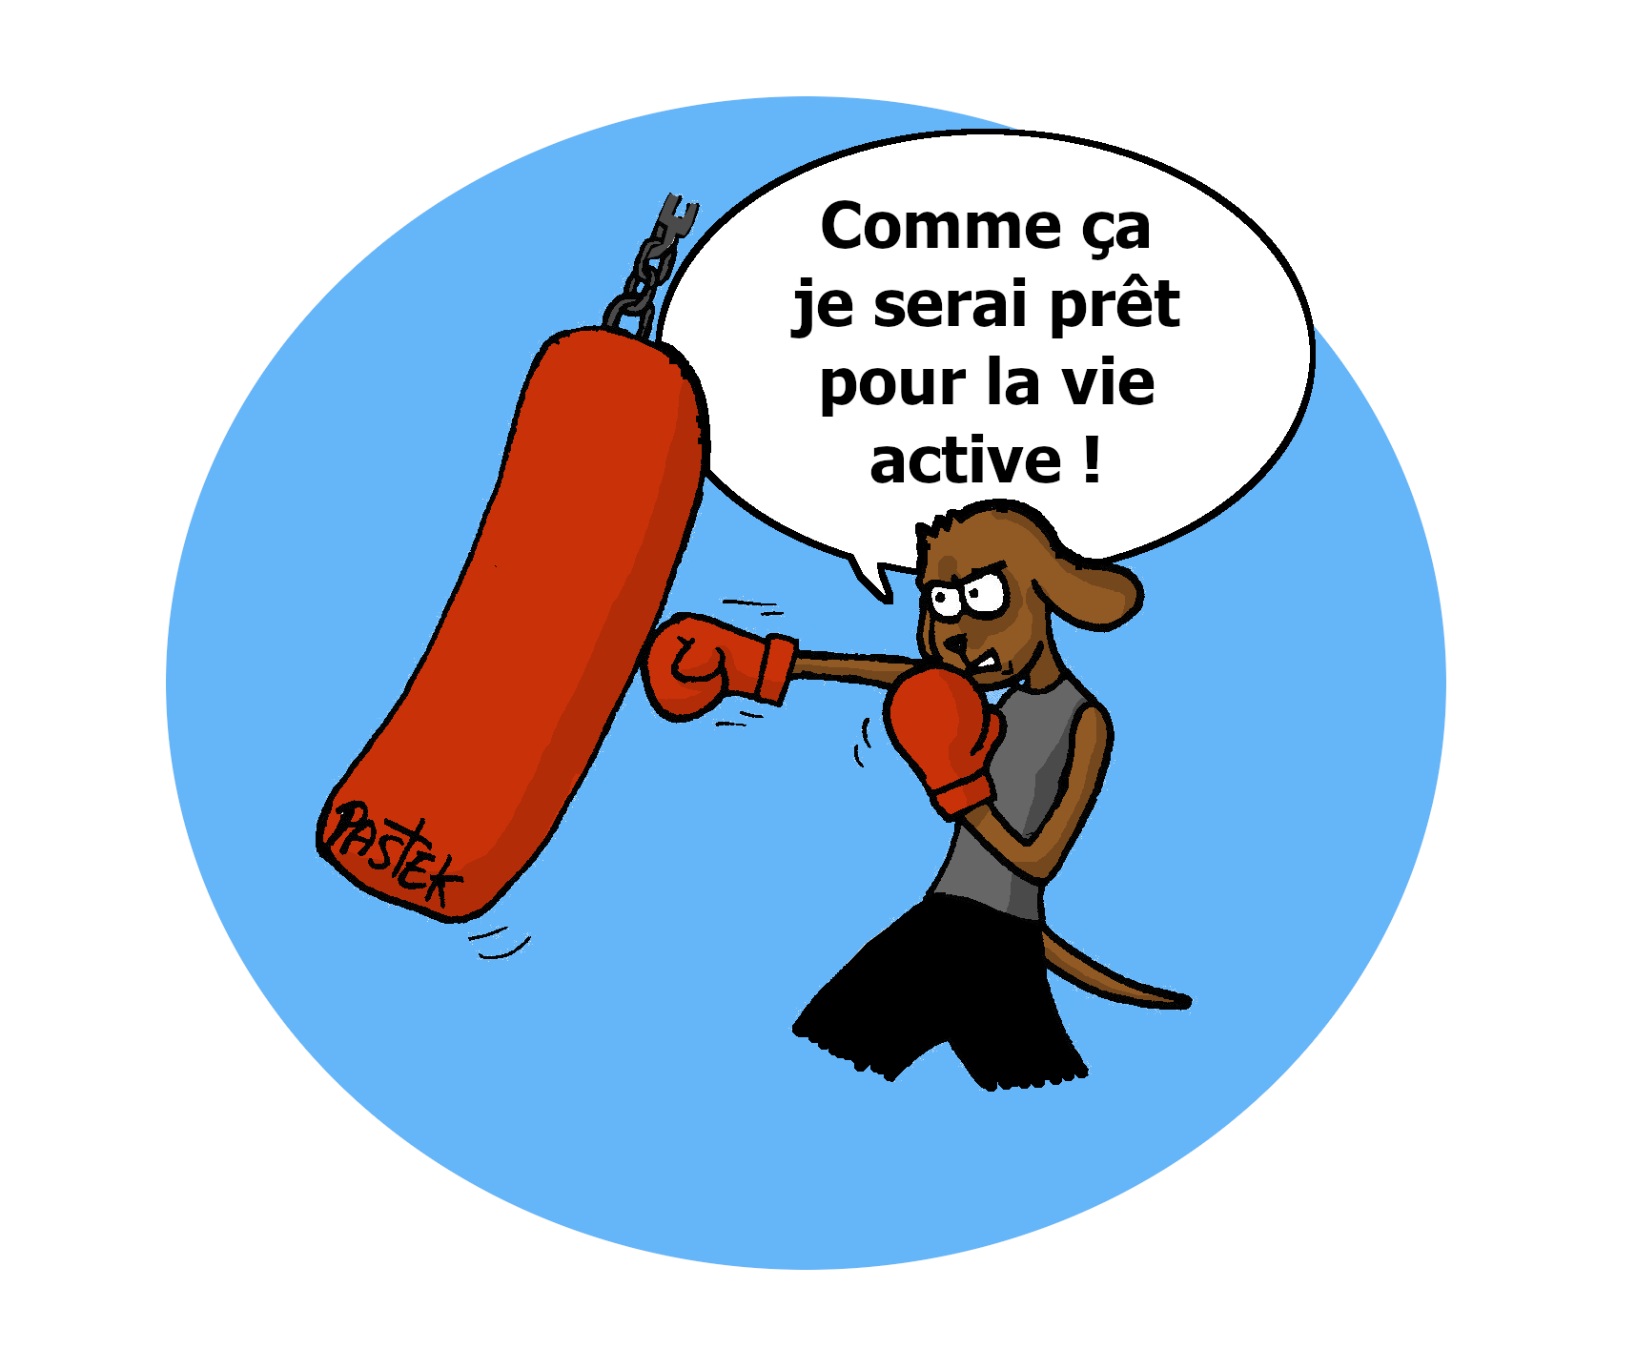
An HR computer system to link networked actions in Human Resources
► An IT platform: matching algorithm on preference or brake of professionals, quality HR management, training
New organization and management of the collective: increase in the "power to act" of Social Entrepreneurs; better response to the expectations of users/professionals/employers, as well as to financial needs
Link and mutual acculturation between aid professionals and building professionals: eco-responsible adaptation of the environment taking into account users and professionals; inter-professional training

Slide 32
Summary of our key differentiators
The matching algorithme
orchestrated to fill the gaps in the uberized systems
Human Resources Policy
conditioned to be control of one’s life path within the collective
The financial package
developed with social cohesion in mind
The climate and environmental challenge
Implemented in educational awareness-raising activities and in the services offered (local and sustainable concept)

Slide 33
Our financial needs
► €1,820,000 over 3 years
HR design and management
Specific computer system design (and its maintenance)
Self-financing action at the end of year 3
Design | Computer System | HR
Year 1 | €500,000 | €380,000
Year 2 | €150,000 | €320,000
Year 3 | €150,000 | €320,000
S/total | €800,000 | €1,020,000
TOTAL | €1,820,000
A financial investment in a project of general interest

Slide 34
Association Yes Together France Guardian of the concept and project
Budget 2023-24
Travelling expanses | €10,200
Office automation costs | €1,000
Web site re design | €10,000
Total | €21,200

Slide 35
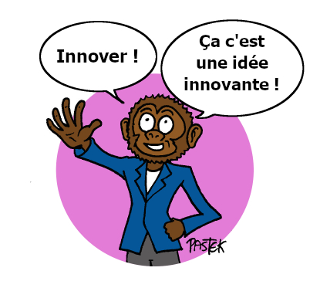
PROJECT PROGRESS REPORT
Design of the Laos component in 2023
New mission planned for fall 2024
Design of the France component finalised for experimentation

Slide 36
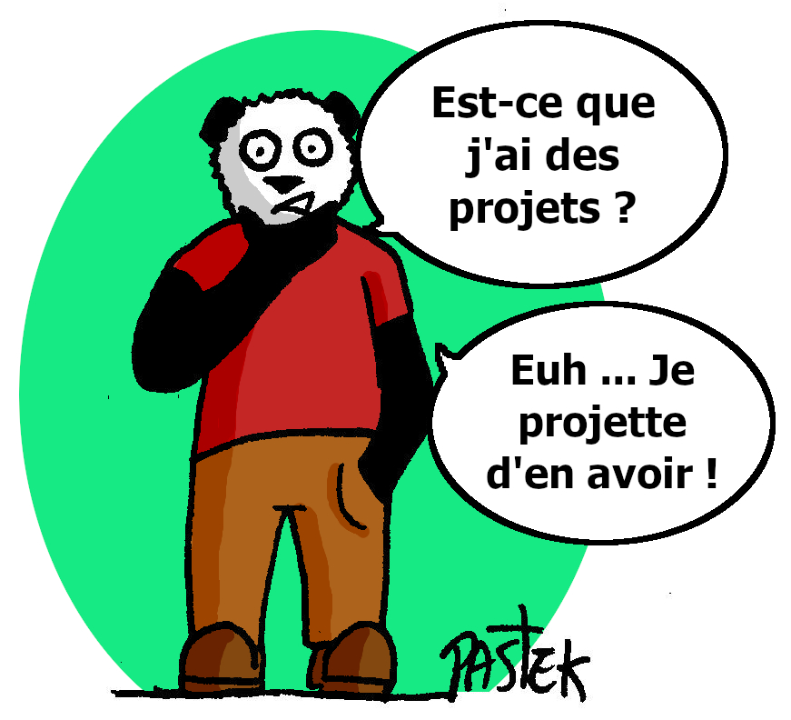
DESİGN OF THE LAOS COMPONENT İN 2023
► Mobilising a supportive network for "Maintaining balance and good health", "Living place" and "Social life":
To study the demands expressed in order to develop the concept Yes Together at Vientiane
To analyse the motivations of project conceptors of the projects envisaged for Luang Prabang before Covid
We continue to support Melissa: NK SEEDS
Green Vientiane with Serge: envisaged in partnership

Slide 37
DESİGN OF THE FRANCE COMPONENT FİNALİZED FOR EXPERİMENTATION
Period 1 – Financial plan developed with 3 of the 7 clusters:
1
Support services to maintain autonomy at home
2
A choice of home services
3
Building renovation services
Period 2 – Four complementary activities:
They support the development of eco-responsible projects serving living being in local areas.

Slide 38
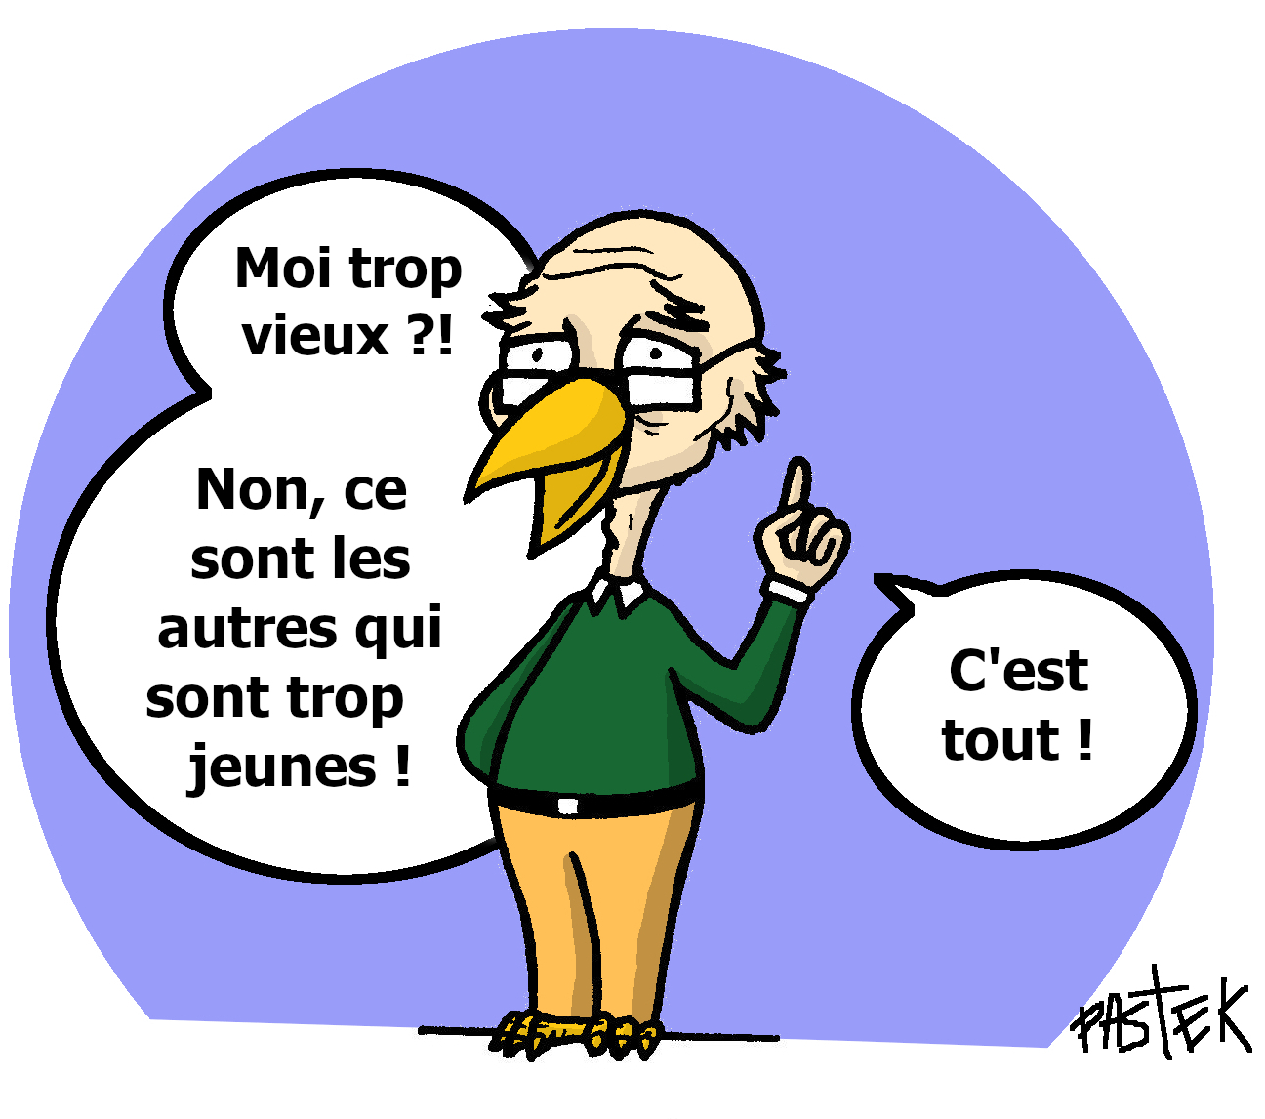
Maintaining independence at home
Specific contributions France:
1
The Yes Together project design process relies on the same driving forces as a start-up that has raised €3 million for its services to people in need of care, namely:
Yes Together completes this proposal:
► Ensuring the stability of professional carers through skills and personality that meet their needs
Focus on discrimination that leads to abuse and dismissal
Addressing families’ concerns about the cost of benefits (before tax reduction and social assistance)
► Revalue professional caregiver’s salaries by more than 20% with a matching algorithm that reduces costs and generates margin
An example : need for 22.5 hours of support per week
Cost of gross monthly benefit Yes Together €1679
Cost of the monthly gross service Start-up €2211
That is a saving of €532 per month and €6384 per year

Slide 39
A choice of home services
Specific contributions France:
2
3
Building renovation services
Supporting individuals to determine in which form and by which professionals services* can be provided in their homes
To provide actors in the building sector with:
- Markets tailored to technicians in professional wear-and-tear
- Advice on FMJS** and CSR*** by participating in the training and recruitment of personnel
Home-based trades integrated into the local economic landscape through solidarity-based bridges with partners targeted as key players
2
3
* To date 26 activities divides into three groups
** FMJS : Forecasting Management of Jobs and Skills
*** CSR : Corporate Social Responsibility

Slide 40
Evaluation France
At the HR level: rate of turn over the employees, attractiveness of eco-responsible partners
At the managerial level: missions, job description, organisations, processes implemented to ensure transferability
At the human level: experience of users and professionals
At the economic level: return to employment, cost of dismissal on the cost of the project
Culture of proof by identifying objective parameters for measuring the effectiveness of the project interacting between the « Human » and the ecosystem

Slide 41
Expected results France
NUMBER OF RESOURCES PAİD MAİNTAİNED İN ACTİVİTY | Year 3 | Year 5 | Year 10
Yes Together Social Entrepreneurs | 284 | 635 | 1335
Senior workers Over 45 *These figures do not include the younger generation recruited in companies to replace senior workers in private homes | 595* | 1375* | 2920*
TOTAL | 879 | 2010 | 4255
NUMBER OF DEPARTEMENTS DEPLOYED | 7 | 11 | 21

Slide 42
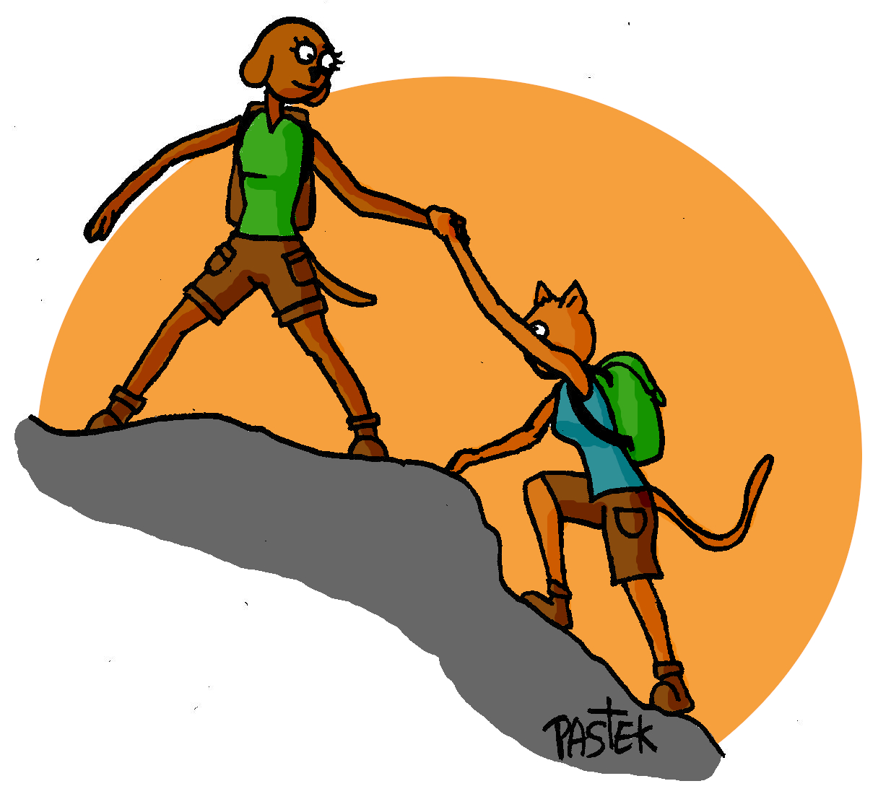
CONCEPT DEVELOPMENT
At the local, national et international level
In a dual network approach:
Yes Together is supported directly or indirectly by a variety of individuals and actors
Yes Together is itself an actor that accompanies people and projects
Join us!
Website: www.oui-ensemble.org

Slide 43
« To be a man is precisely to be responsible… It is to feel, by laying one's stone, that one is contributing to building the world. »
Antoine de Saint-Exupery
Thank you
Contact: asso.ouiensemble@gmail.com

