Slide 1
« THE LİVE İN ACTİON » Yes Together

Slide 2
Project context
"Together, we can create a better future for everyone!"

Slide 3
With what new "Product-Service"?

Slide 4
None!
We have reinvented a Network Organization with principles for
« Aging Well Together for a Long Time»

Slide 5
Project Principles:
Inclusion This project promotes inclusion and diversity for a fairer world.
Solidarity The project emphasizes solidarity and mutual aid for a better future.
Progress Oui Ensemble aims to build a better future for all based on social and economic progress.

Slide 6
Due to the volume of problems and the lack of funding to solve them!
Why this project?
We are establishing a different form of cooperation, both locally and nationally and internationally, to "Work differently," "Live with dignity,"
and "Age peacefully."

Slide 7
Pragmatic and realistic entrepreneurs first and foremost!
Who are we?
→ We know that a future can only be possible under the condition of new ethics that must materialize through the securing of human resources.

Slide 8
Harmonious cooperation serving living beings!
Oui Ensemble
promotes social inclusion and activity at all ages, helping everyone to stay active.

Slide 9
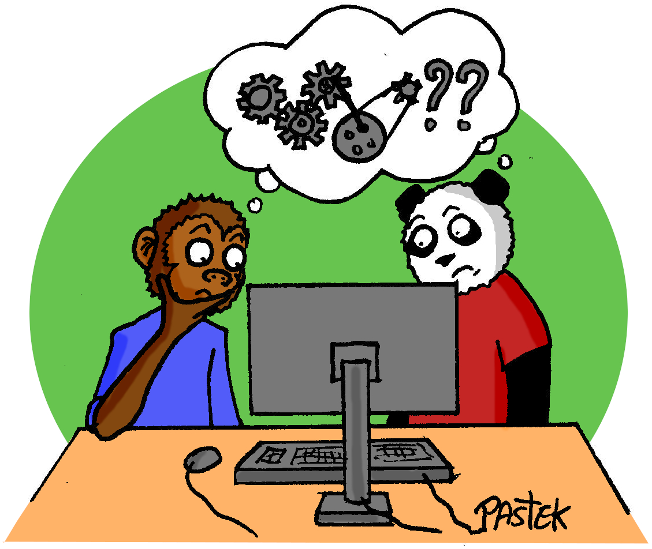
The Oui Ensemble Network Organization carries a
"Human Resources recipe" designed in a Bottom-up approach, meaning ideas and initiatives come from the bottom. It includes the marketing approach and the use of the global and transversal project design process.

Slide 10
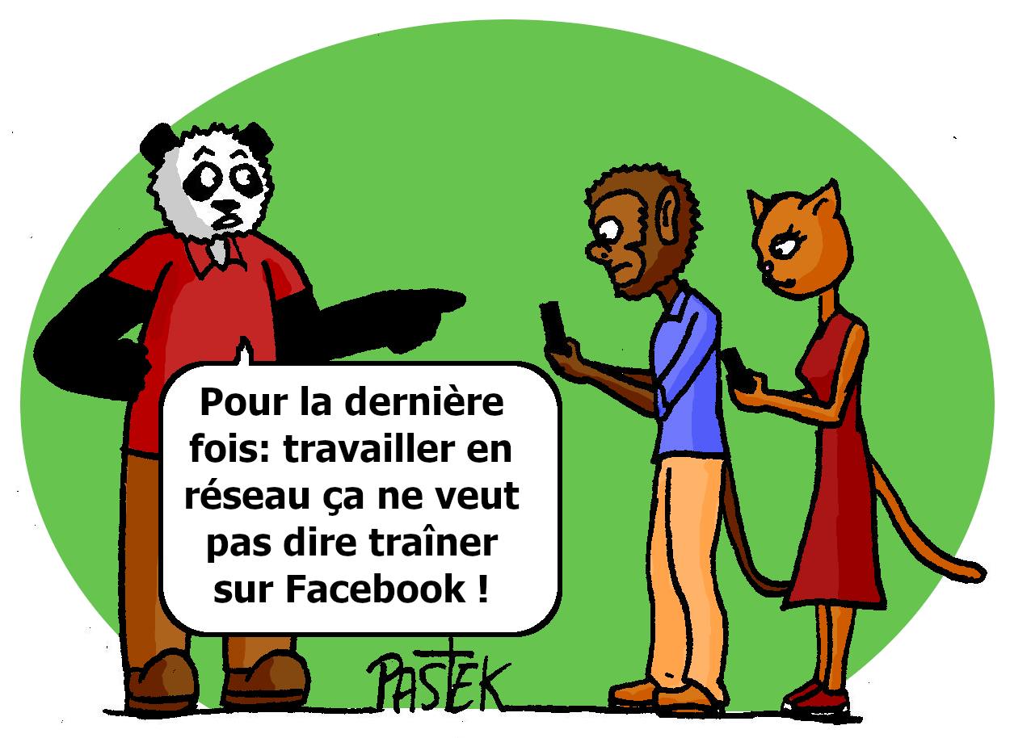
Working as a team with
Human Resources
Active committed, trained and valued citizens.
Missions: Remain autonomous and active, have jobs and missions that are valued, receive training, work close to home.
Requirements: Delay dependency, avoid illegal channels, earn a decent income, stay connected without isolation.

Slide 11
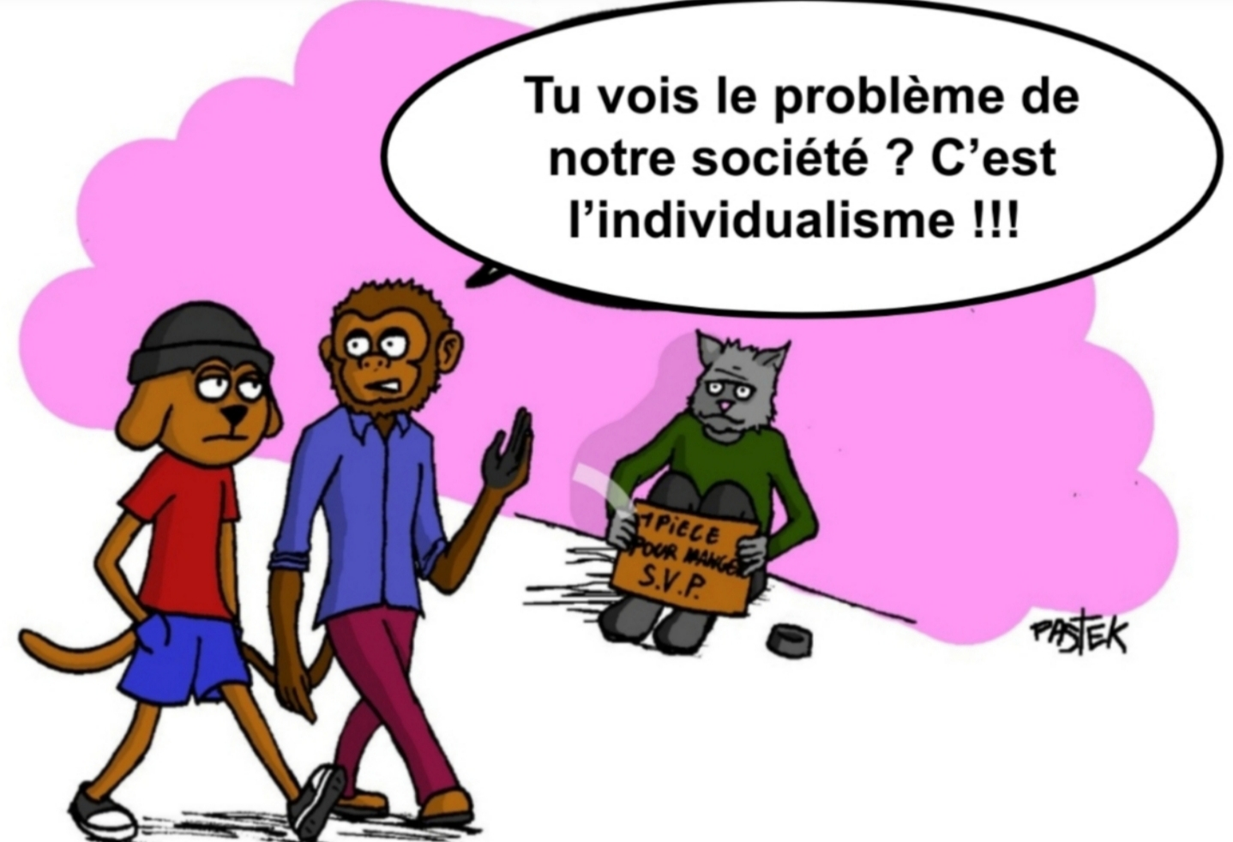
Working as a team with
Service Beneficiaries
Ethical HR services of high quality, meeting individualized needs.
Missions: Collaborate in the solidarity network, receive ethical services of high quality.
Requirements: Simplicity of service management, building relationships based on trust, being able to finance the services received.

Slide 12
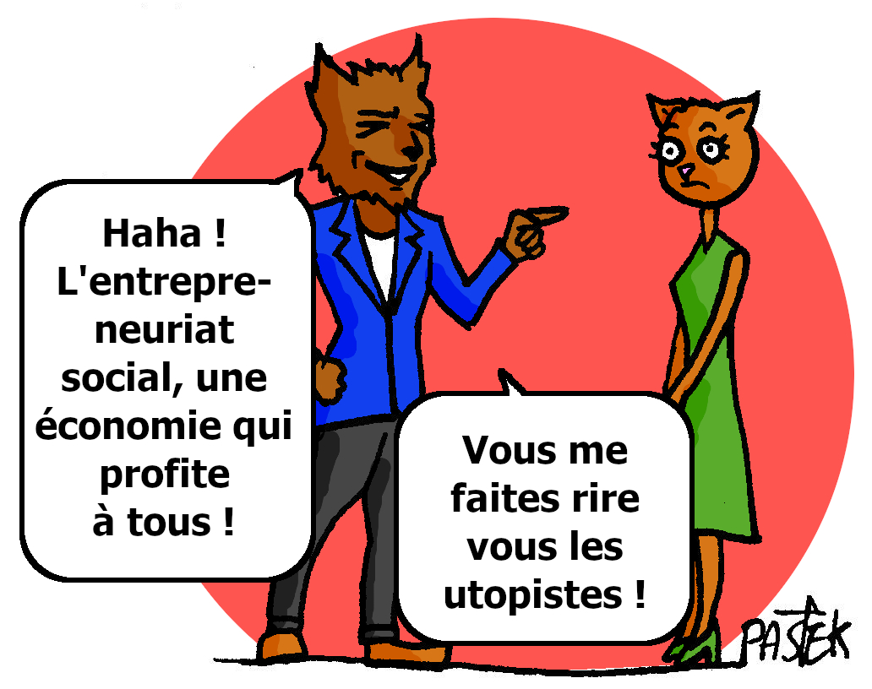
Teaming up with Oui Ensemble
Social Entrepreneurs
Dynamic social innovators, supported by
a fair circular economy.
Missions: Raise awareness and educating, initiating and undertaking projects, carrying the concept of living « Aging Well Together for a Long Time ».
Requirements: Respect for ethics, working together in multi-disciplinary teams, offering personalized services.

Slide 13
In FRANCE and LAOS
Oui Ensemble Social Entrepreneurs apply a specific management method within each neighborhood, working in
a spirit of companionship with third places adapted to the territories.

Slide 14
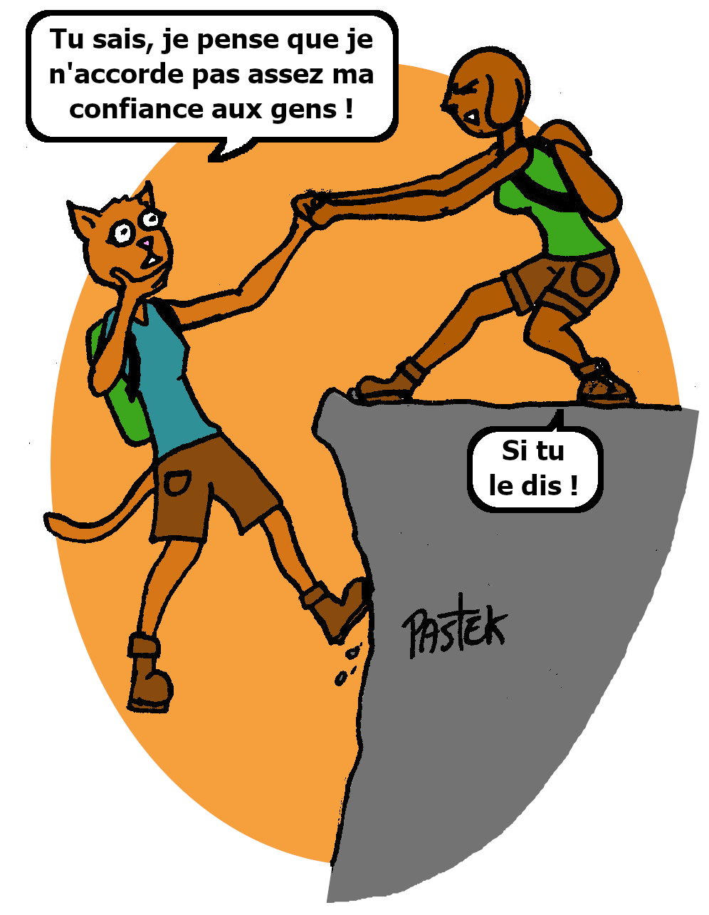
IMPACT ET BENEFİTS The public interest project Oui Ensemble create a solidarity network for an inclusive and sustainable future.

Slide 15
DİSCOVER HOW OUİ ENSEMBLE REVOLUTİONİZES SOCİAL İNCLUSİON AND MAİNTAİNİNG ACTİVİTY THROUGHOUT LİFE
Contact us to learn more!
Email : asso.ouiensemble@gmail.com
Web site : Oui-Ensemble.org

